Slide 1
INVESTMENT ASSIGNMENT SUBMISSION
Name:Vedika

Slide 2
Objective
Help Spark Funds with investments in emerging markets across countries.
Below are few constrains defined by Spark Funds
Invest between 5 to 15 million USD per round of investment.
Invest only in English speaking countries.

Slide 3
Problem solving methodology
1.Identify top invested sectors
2.Indentify top English speaking countries
3.Identify suitable investment type based on constrain of 5 Millions-15 Millions
Group together company details and round-wise investment details
1.Decide investment type: Group the merged data based on different investment types, find representative value of investment amount received under each investment type.
2.Find top invested countries: Group the merged data based on different countries, find total investment amount received for each country and finally select top 3 English speaking countries.
3.Identify heavily invested sectors in the top 3 countries for the chosen investment type.

Slide 4
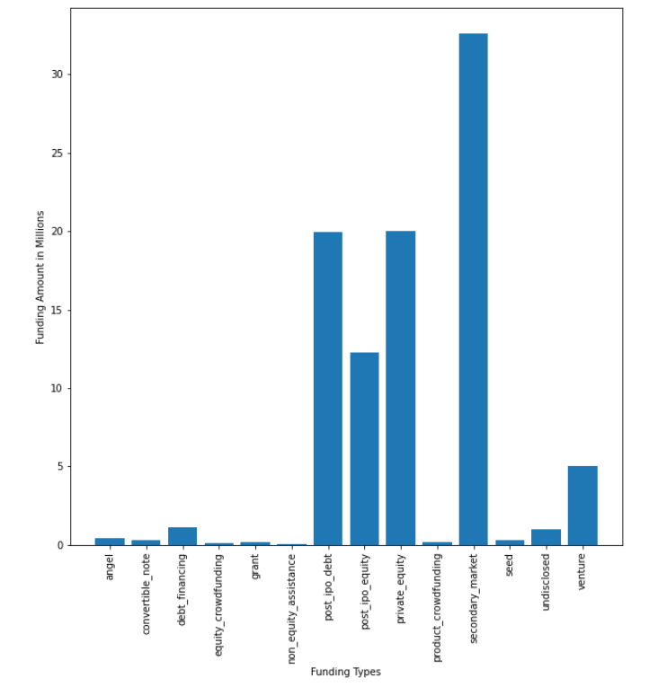
Results
Plot 1:
Figure shows the representative amount of investment under each funding type.
Here we observe that “venture” and “post_ipo_equity” fall in the range of investments specified by Spark Funds

Slide 5
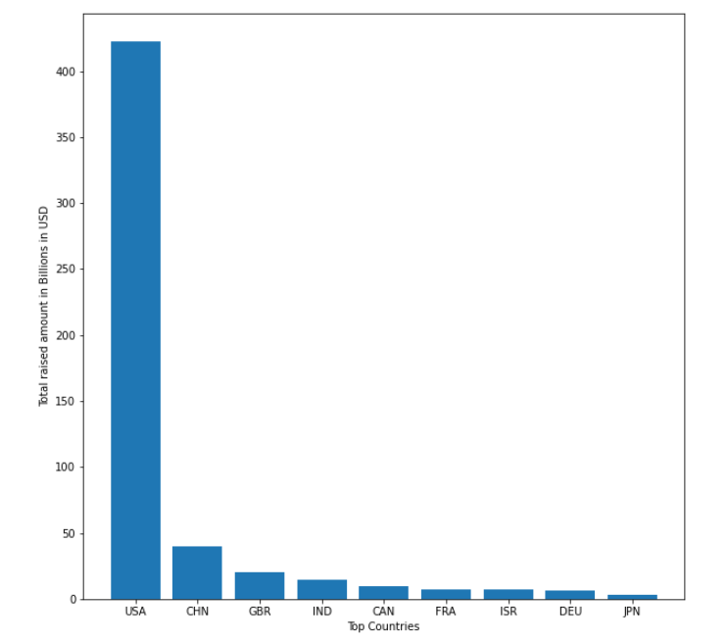
Results
Plot 2
Figure shows the top 9 countries against the total amount of investments of funding type “venture”.
We observe that USA is the most invested country, followed by China, Great Britain, India.
We have skipped China, as its not an English speaking country.

Slide 6
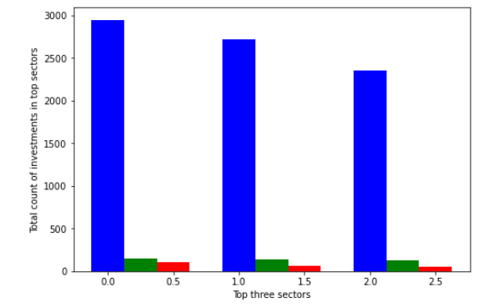
Results
Plot 3
Figure shows the number of investments in the top 3 sectors of the top 3 countries on one chart.
Where:
1.blue is USA
2.green as Great Britain
3. red as India

Slide 7
Conclusions
1.USA,Great Britain and India are the top 3 countries where Spark Fund can invest.
2.Venture funding type is most suitable funding type fulfilling constrains of 5M-15M.
3.Following are top sectors country wise with highest count of investments
a.Top 3 sectors which received highest number of investments in USA
#others:2950
#social, finance, analytics, advertising:2714
#cleantech / semiconductors:2350
b.Top 3 sectors which received highest number of investments in Great Britain
#others:147
#social, finance, analytics, advertising:133
#cleantech / semiconductors:130
c.Top 3 sectors which received highest number of investments in India
#others:110
#social, finance, analytics, advertising:60
#news, search and messaging:52

